Slide 1


Recommender Systems: Personalizing Your Digital Experience
Imagine browsing an online store and discovering a new product you love, or scrolling through your social media feed and encountering engaging content that aligns with your interests. This personalized experience is powered by recommender systems, intelligent algorithms that analyze your preferences and predict what you'll enjoy next.
Prudhvi Naidu Thota
AP22110010077

Slide 2


Types of Recommender Systems
1
Content-Based Filtering
2
Collaborative Filtering
3
Hybrid Filtering
This approach analyzes your past interactions with content, such as books, movies, or products, to identify common themes and patterns. It then recommends similar items based on your past preferences.
This method focuses on the behavior of similar users. It identifies users with tastes similar to yours and recommends items they've enjoyed. This method is particularly useful for discovering new items you might not have considered otherwise.
As the name suggests, hybrid filtering combines both content-based and collaborative filtering techniques. This approach leverages the strengths of each method to create a more comprehensive and accurate recommendation system.

Slide 3


Content-Based Filtering
How it Works
Example
Content-based filtering analyzes the content of items you've interacted with, identifying keywords, themes, and features. It then recommends similar items based on these attributes.
If you've consistently enjoyed science fiction movies, a content-based system might recommend other science fiction movies with similar themes, directors, or actors.
Advantages
Limitations
Content-based filtering is effective for discovering new items within a familiar genre and can personalize recommendations based on individual preferences.
It can struggle to recommend truly novel or unexpected items and may limit you to your existing preferences.

Slide 4
Collaborative Filtering
Understanding User Similarities
Recommending New Items
Example
This method is effective for discovering new items you might not have considered otherwise, expanding your horizons and introducing you to new experiences.
If you've rated a particular movie highly and other users with similar tastes have rated another movie highly, the system might recommend that movie to you.
Collaborative filtering analyzes the behavior of users with similar tastes to yours. It identifies common preferences and recommends items those users have enjoyed.

Slide 5





Hybrid Filtering
Combining Strengths
Hybrid filtering combines the strengths of both content-based and collaborative filtering, leveraging the best of both worlds to create a more comprehensive recommendation system.
Personalized Recommendations
This approach considers both your individual preferences and the preferences of similar users, creating personalized recommendations that are both familiar and exploratory.
Example
A hybrid system might analyze your past movie ratings to identify genres you enjoy and then recommend movies with similar themes that have been rated highly by users with similar tastes.

Slide 6


Advantages of Recommender Systems
Increased User Engagement
Recommender systems can keep users engaged by providing personalized content and recommendations that are relevant to their interests.
Improved Customer Experience
By offering tailored recommendations, these systems enhance customer satisfaction and provide a more seamless and enjoyable browsing experience.
Increased Revenue
Personalized recommendations can lead to increased sales, as users are more likely to purchase products they are genuinely interested in.
Reduced Search Time
Recommender systems can help users quickly find the information or products they need, saving them time and effort.

Slide 7


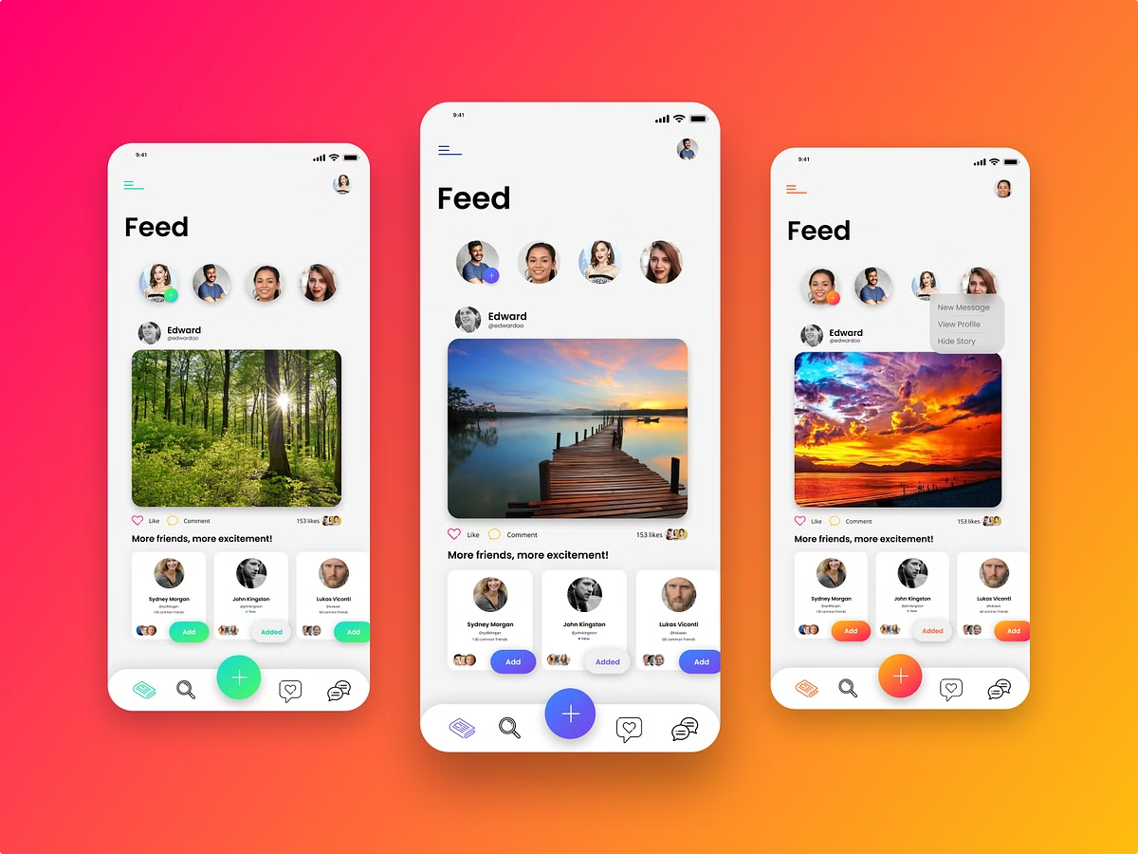


Social Media Recommendation Example
Personalized Content
Social media platforms use recommender systems to personalize your news feed, highlighting posts, videos, and articles that align with your interests and past engagement.
Engaging Interactions
These algorithms recommend posts and content that are likely to spark your interest and encourage you to interact with the platform, fostering a sense of community.
Discover New Content
Social media recommender systems can also introduce you to new creators, topics, and perspectives that you might not have encountered otherwise, expanding your horizons.

Slide 8


Conclusion and Key Takeaways
Recommender systems are becoming increasingly ubiquitous, shaping our digital experiences and influencing our choices. By understanding the different types of recommender systems and their advantages, we can better navigate these personalized environments, making informed decisions and discovering new content that aligns with our interests.

